Slide 1
https://bit.ly/3EdnFEE

Slide 2


Predict Purchase Intention using Amazon Sagemaker
Wyne Tan
AWS Educate Team SCU Lead

Slide 3





About Me
（Wyne Tan）
2020/2021 AWS Educate Student Ambassador @AWS
Frontend Engineer & QA Engineer @中研院
法律
科技
雲端
運算
LinkedIn
WEI-JIE, (Wyne) TAN
Github
sefx5ever
金融
科技

Slide 4
Agenda
The basics of Machine Learning
Machine Learning Workflow
Introduction of Amazon S3
Introduction of Amazon Sagemaker
Hands-on Machine Learning Project

Slide 5
The basics of Machine Learning
Three type of Machine Learning

Slide 6
Three types of
Machine Learning
Artificial Intelligence
（AI）
Machine Learning
（ML）
Supervised Learning （監督式學習）
Unsupervised Learning
（非監督式學習）
Reinforcement Learning
（強化學習）
Supervised
Learning
Unsupervised
Learning
Reinforcement
Learning

Slide 7
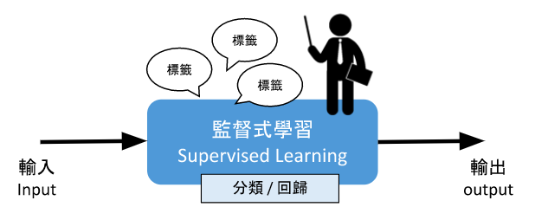
Supervised Learning
全部資料需要被標記（Label）
可分為回歸與分類

Slide 8
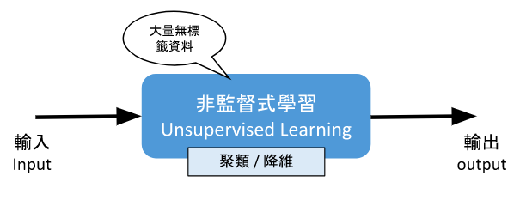
Unsupervised Learning
全部資料無需標記（No Label）
可分為聚類或降維

Slide 9
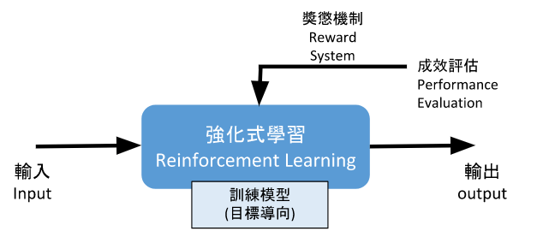
Reinforcement Learning
藉由 Agent 重複的在 Environment 中透過不同 State 的反饋 來執行相應的 Action，然後透過 Reward Function 進行調校

Slide 10
Machine Learning Workflow
Workflow Overview
Different Stages in Machine Learning Workflow

Slide 11
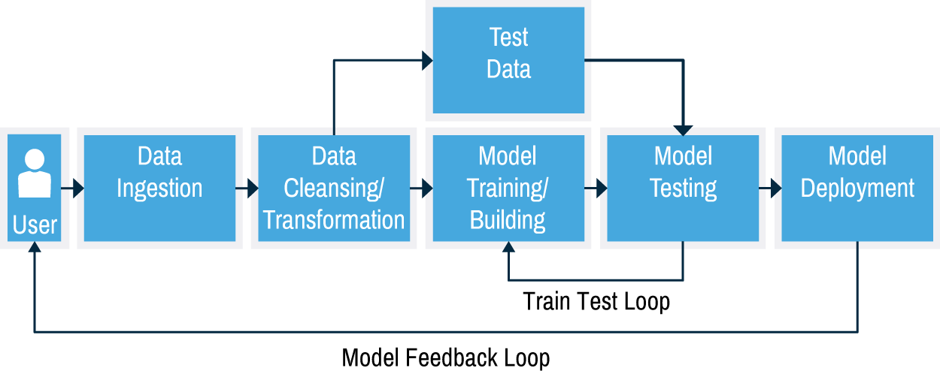
Workflow Overview

Slide 12
Data Ingestion
Data ingestion is the process of moving data from a source into a landing area or an object store where it can be used for queries and analytics.
Challenges
Complexity Takes Time
Change Takes Time
Maintenance and Rework Takes Time
Tools
Hand Coding
Single-purpose Tools
Data Integration Platforms
A DataOps Approach
https://streamsets.com/learn/data-ingestion/

Slide 13
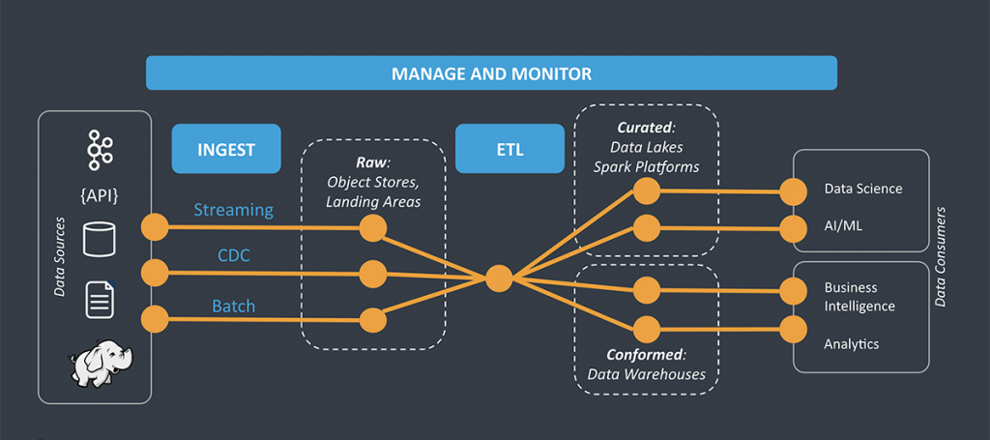

Slide 14
Workflow Overview

Slide 15
Data Cleansing
Data cleansing or data scrubbing is the process of detecting and correcting (or removing) corrupt or inaccurate records from a record set, table, or database.
Evaluation Index
Validity：確認是否每筆資料皆與資料制定的 Schema 一致。
Accuracy：資料所標示的值是否合理正確。
Completeness：資料是否完整。
Consistency：資料欄位之間若有關聯，彼此之間是否一致，而不產生矛盾。
Unifornity：每筆資料相同欄位所使用的單位是否統一。

Slide 16
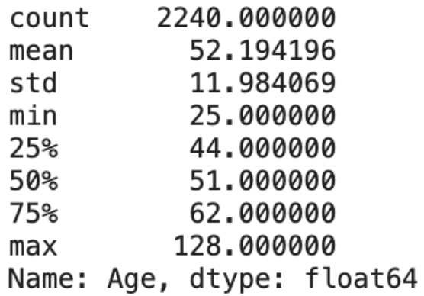
Data Transformation
Data transformation is the process in which data gets converted from one format to another.
Techniques
Data Smoothing
Data Aggregation
Discretization
Generalization
Attribute Construction
Normalization
https://www.zuar.com/blog/data-transformation-types-process-benefits-and-definition/

Slide 17
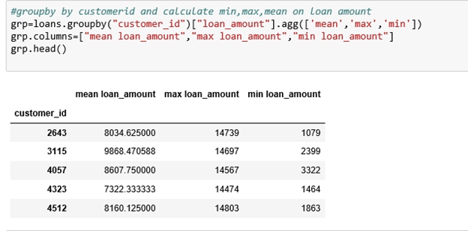
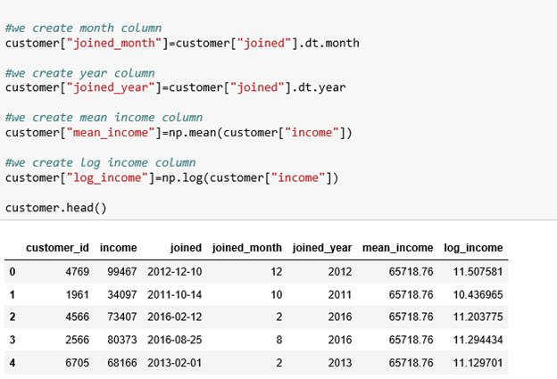

Slide 18
Workflow Overview

Slide 19
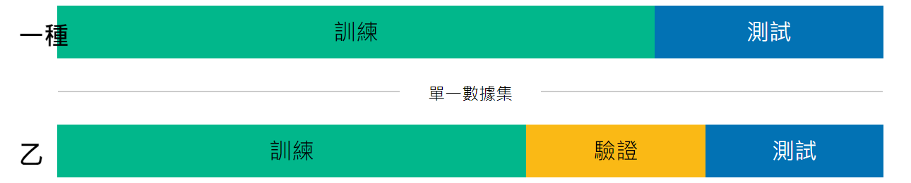
Training / Validation / Test Data
Train Data：課本、講義
Validation Data：模擬考
Test Data：學測、指考

Slide 20
Model Training
Artificial Intelligence
（AI）
Machine Learning
（ML）
Supervised Learning （監督式學習）
Unsupervised Learning
（非監督式學習）
Reinforcement Learning
（強化學習）
Supervised
Learning
Unsupervised
Learning
Reinforcement
Learning

Slide 21

Model Evaluation
分類指標
混淆矩陣
ROC 曲線
AUC 曲線
回歸指標
平均均方誤差 MSE
平均絕對誤差 MAE
…

Slide 22
Workflow Overview

Slide 23

Amazon S3
Introduction of Amazon S3
The Concept of Object
The basics of Amazon S3

Slide 24







Simple Storage Service（S3）
Object-based 物件式儲存
Bucket
https://godleon.github.io/blog/AWS/AWS-CSA-associate-S3-part1/

Slide 25
Simple Storage Service（S3）
Key：Object Name（檔案按字母排序）
Value：資料本身（一堆 Byte 的組合）
Version ID：版本控管用途
Metadata：額外用來記錄 Object 相關資訊的資料，使用者也可以自訂客製化的 Metadata，藉此來為 Object 標註不同的屬性值
https://godleon.github.io/blog/AWS/AWS-CSA-associate-S3-part1/

Slide 26
S3 小知識
單一檔案大小的限制為 0 bytes ~ 5 TB，整體的儲存空間無限制
檔案一律存在 Bucket 中
單一帳號預設最大上限可存放 100 個 Buckets（可申請提升上限）
S3 裡面的每個 Bucket 都會有一個全球獨一無二的 DNS 名稱
若特定的區域，則可能是 https://YOUR_UNIQUE_BUCKET_NAME.eu-west-1.amazonaws.com 但無論如何，用戶只要記住 Bucket Name 即可
https://godleon.github.io/blog/AWS/AWS-CSA-associate-S3-part1/

Slide 27

Amazon Sagemaker
Introduction of Amazon Sagemaker
Amazon Sagemaker Function Overview

Slide 28
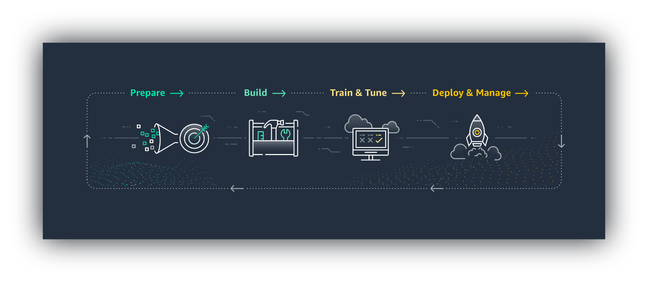
Amazon Sagemaker
整合專門為 ML 建置的一組廣泛的功能，協助資料科學家和開發人員快速準備、建置、培訓、部署高品質的機器學習模型。

Slide 29
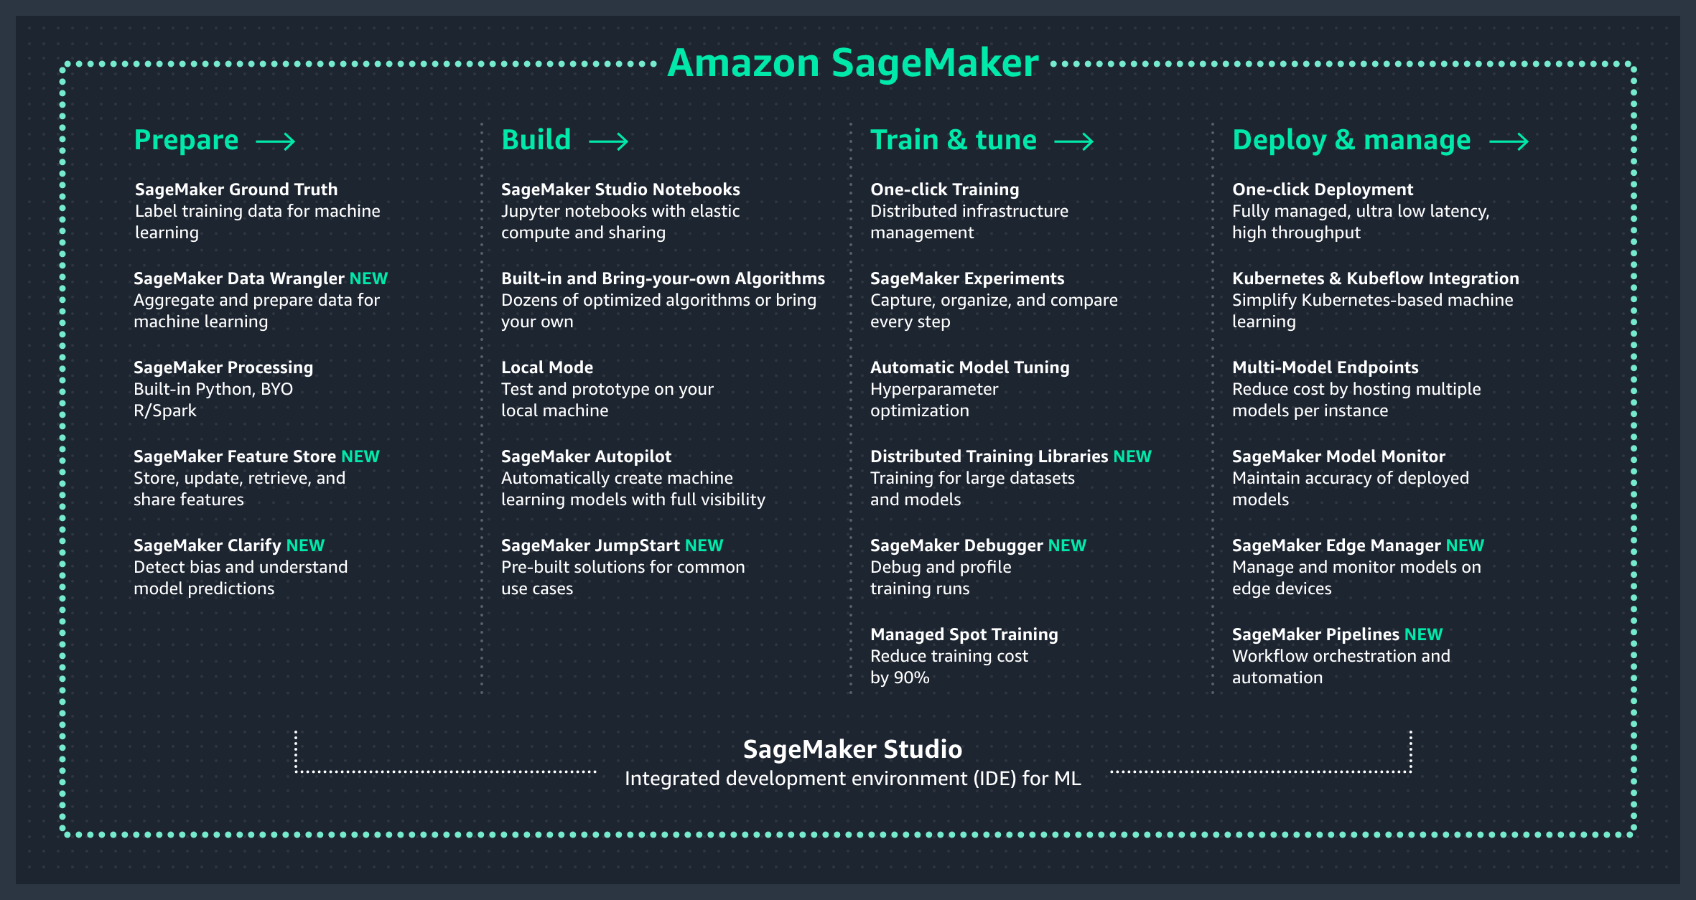

Slide 30
Hands-on Machine Learning Project
Solution Architecture of ML Project
Upload IPYNB to Jupyter Notebook

Slide 31




Solution Architecture of ML Project
AWS Cloud
Get / Save Data
Amazon Simple Storage Service (Amazon S3)
Amazon SageMaker
Click ME and Download Sample Code

Slide 32
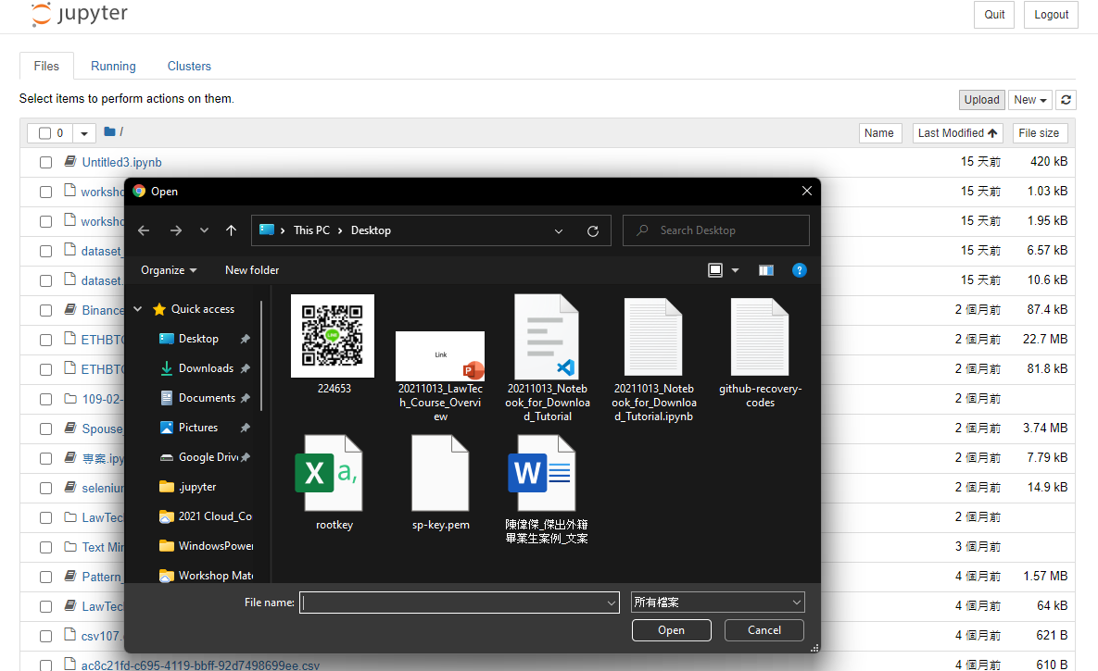
Upload a Python Project – STEP 1
STEP 1
IPYNB :
Back to “Home Page”
Click on “Upload”
Find the project you
Placed
Click “Open” Button
STEP 2
STEP 3

Slide 33
Upload a Python Project – STEP 2
STEP 1
IPYNB :
Click “Upload” Button
Find out and Tick the project
STEP 3
STEP 2

Slide 34
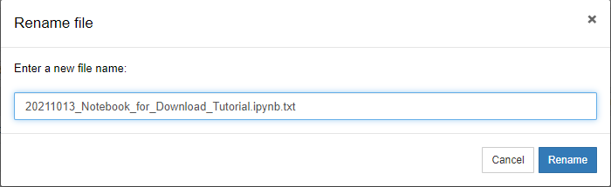
Upload a Python Project – STEP 3
STEP 1
STEP 2
IPYNB :
Delete “.txt” Then
Click “Rename” Button
Open the Project

Slide 35
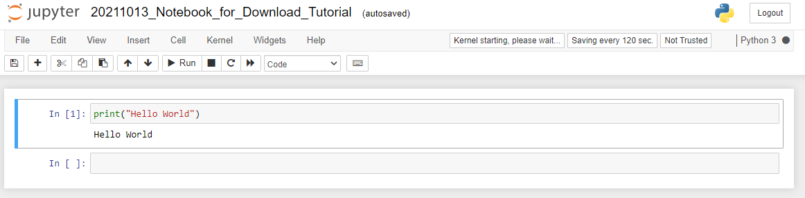
Upload a Python Project – STEP 4
Congratulation !
You had successfully uploaded and opened a project!

Slide 36
Q & A Wyne Tan 土撥 Jie
LinkedIn
WEI-JIE, (Wyne) TAN
Github
sefx5ever

Slide 37
Thank you for your patience.

